Slide 1
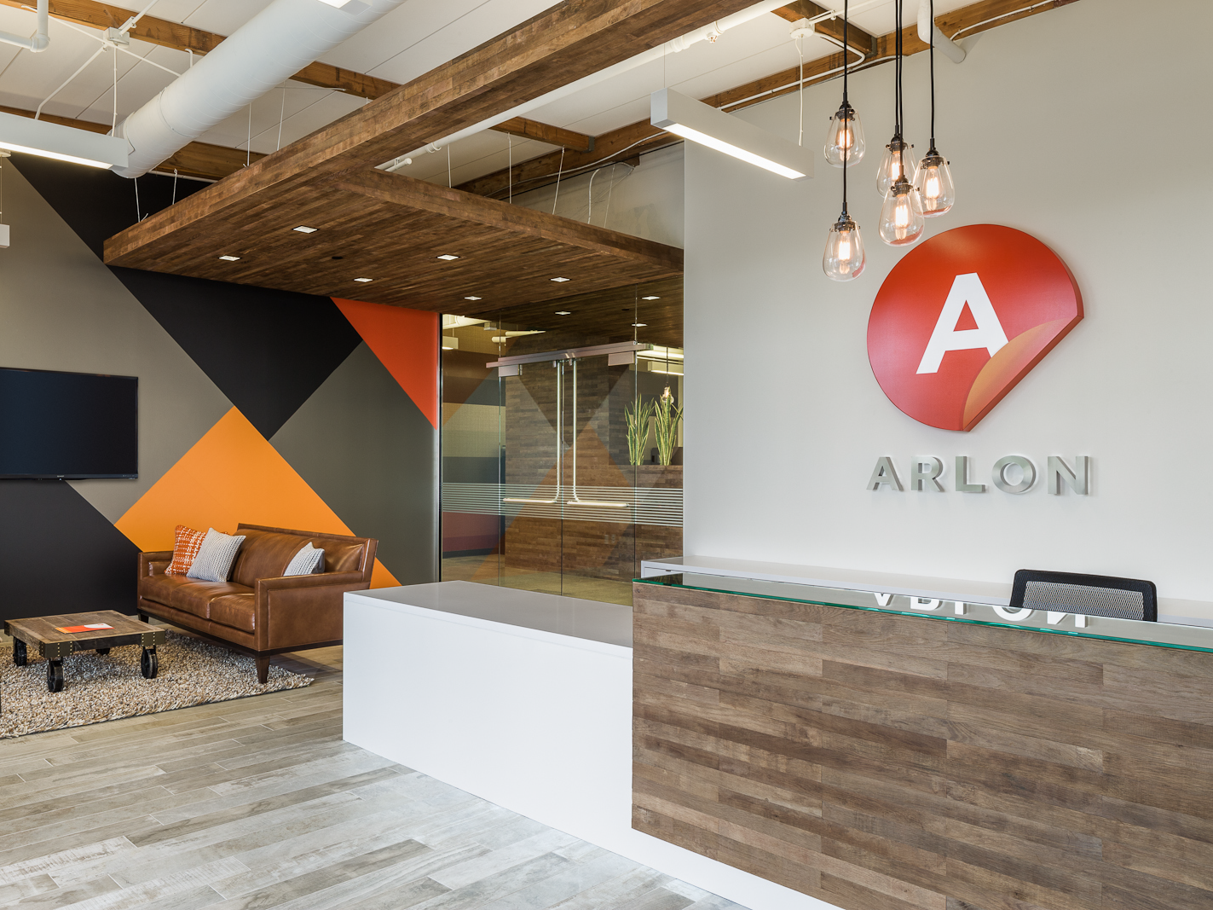
IllumiNITE V2 TS Data Review

Slide 2

Objective
2
Review data collected from testing that was performed by TS (TSC #95835)
Compare performance data between IllumiNITE V2, DPF 2400, and DPF 2400XLP
IllumiNITE V2 tested batches:
  S12180110 (LC - low coat weight ~31 gsm)
  T01230106 (HC – high coat weight ~35gsm)

Slide 3
3
Mirrored | Product | Instant | 15min | 24hr | 1wk
 | IllumiNITE V2 | 2.86 | 3.43 | 4.55 | 7.14
 | 2400XLP | 3.30 | 4.05 | 5.28 | 7.97
 | 2400 | 3.46 | 4.27 | 5.18 | 7.37
 | Avery V4000 |  | 2.55 | 3.16 | 3.04
Notes:
Tested on T0128099 batch

Slide 4
4
Matte | Product | Instant | 15min | 24hr | 1wk
 | IllumiNITE V2 | 2.46 | 2.96 | 4.72 | 7.11
 | 2400XLP | 3.44 | 4.07 | 5.05 | 6.91
 | 2400 | 3.73 | 3.97 | 5.53 | 7.22
Notes:
Tested on T0128099 batch

Slide 5
5
Brushed | Product | Instant | 15min | 24hr | 1wk
 | IllumiNITE V2 | 2.55 | 2.56 | 4.28 | 6.34
 | 2400XLP | 1.84 | 3.50 | 4.67 | 6.83
 | 2400 | 2.59 | 4.00 | 4.63 | 6.62
Notes:
Tested on T0128099 batch

Slide 6
Liner Release
6
IllumiNITE V2 Liner Release
Trial | S12180110(LC) | T01230106(HC)
1 | 74.9 | 98.6
2 | 73.0 | 99.9
3 | 73.0 | 100.4
4 | 85.5 | 101.7
5 | 83.6 | 99.9
Average | 78.0 | 100.1
STDev | 5.4 | 1.0
Online Coated
AVERAGE | 32.9
Avery V4000
AVERAGE | 64.9
Time study of liner release is planned with for next production run
Followed ATM #12 test method
Online coated average taken from QA Test Data
Large discrepancy between TS data vs Online Coat
These batches were 3 and 2 months old (tested on March 25)
Notes:
One batch was aged tested and recorded 54 g/2in

Slide 7
Cut and Weed Data
7
Product | Unprinted |  |  | Grey |  |  | Black
 | 1" | 2" | 3" | 1" | 2" | 3" | 1" | 2" | 3"
V2 LC (~31 gsm) | 86% | 96% | 100% | 96% | 100% | 100% | 96% | 100% | 100%
V2 HC (35 gsm) | 100% | 100% | 100% | 100% | 100% | 100% | 96% | 100% | 100%
2400XLP | 25% | 43% | 60% | 68% | 75% | 96% | 86% | 86% | 93%
2400 | 82% | 89% | 100% | 96% | 96% | 100% | 93% | 96% | 100%
Printed on Roland XR-640, outgas 24hrs (or more), laminated with 3210
Cut on Graphtec FC8600 with red holder (60° blade)
All cut with the same settings
  Force: 23, Speed: 20, Accel: 1, Tangential Mode: ON
No hand assist
Left to Right
Weed within the hour
V2 LC performed poorly initially, but testing was redone later and performed as shown above

Slide 8
Cut Text Transfer
8
Product | Unprinted
 | 1" | 2" | 3"
V2 HC | Pass | Pass | Pass
Unprinted, with 3210, transferred onto Chrysler hood
Cut with same settings as cut/weed test
Medium tack transfer tape was used
Transferred at room temperature

Slide 9
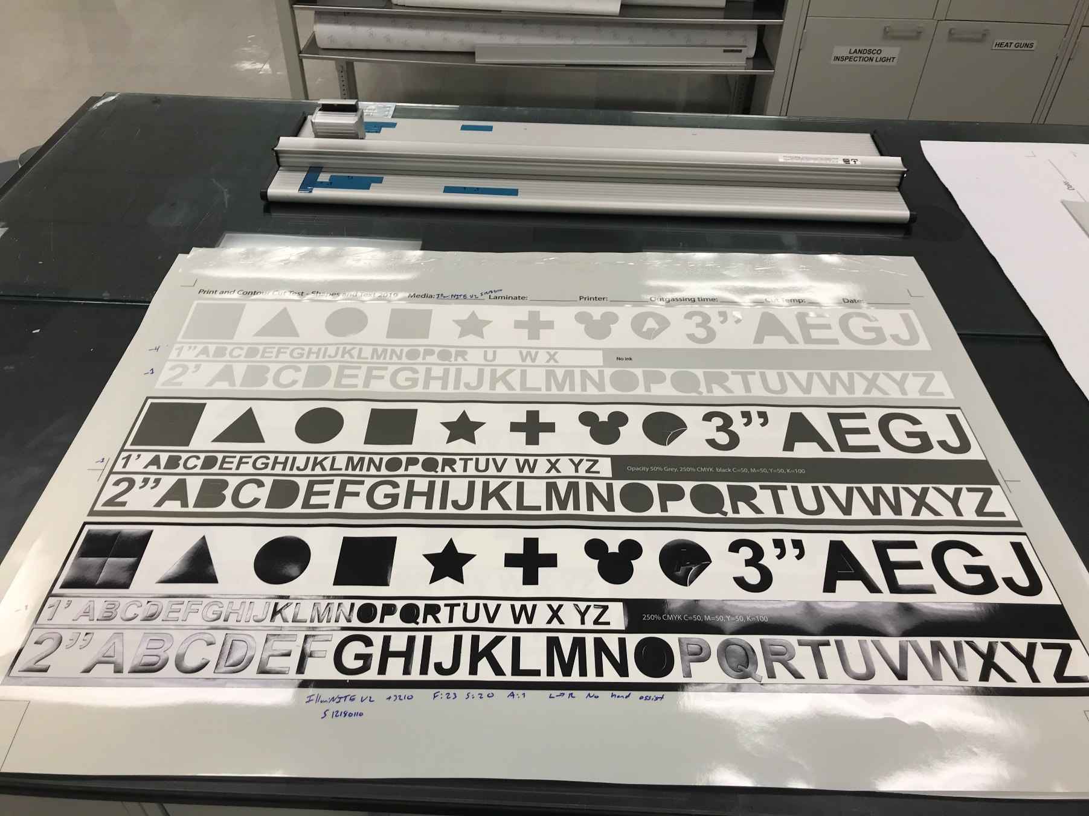
IllumiNITE V2 LC Cut/Weed
9

Slide 10
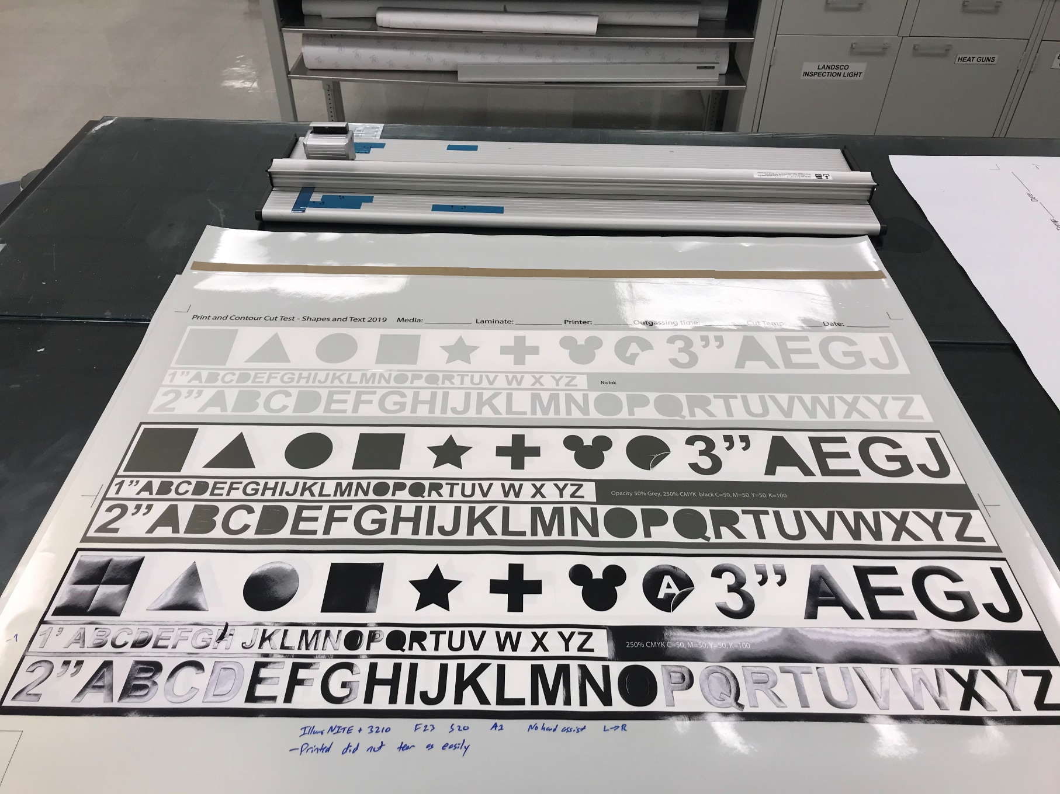
IllumiNITE V2 HC Cut/Weed
10

Slide 11
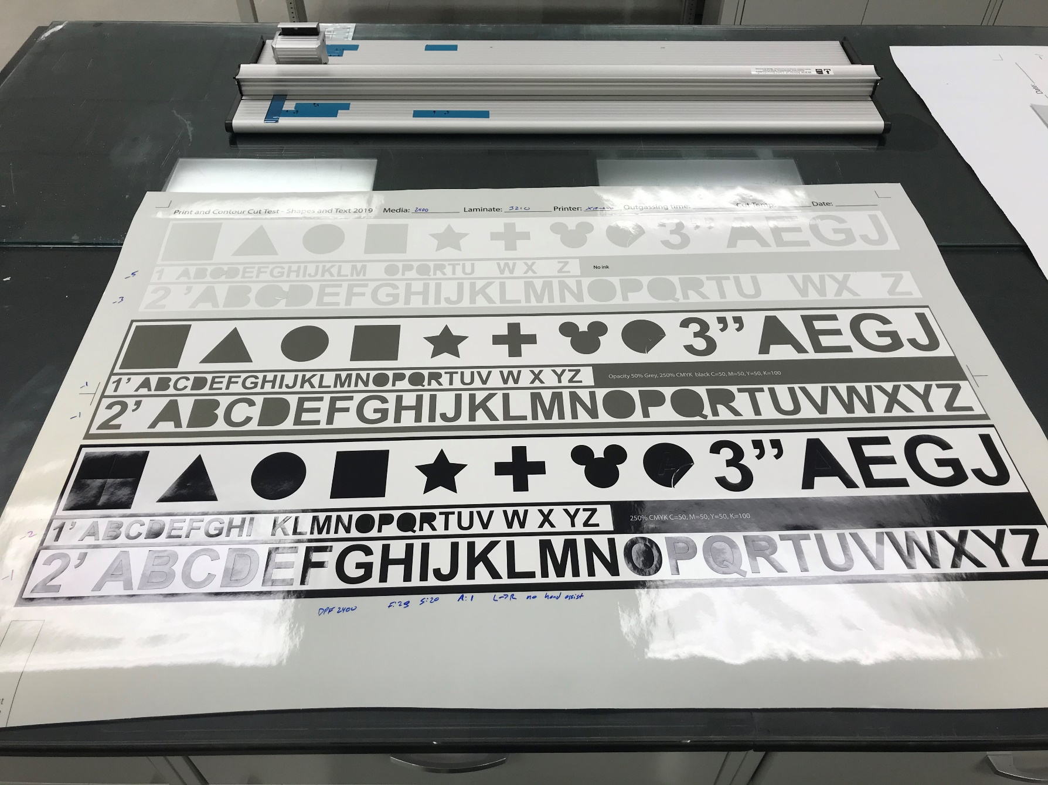
DPF 2400 Cut/Weed
11

Slide 12
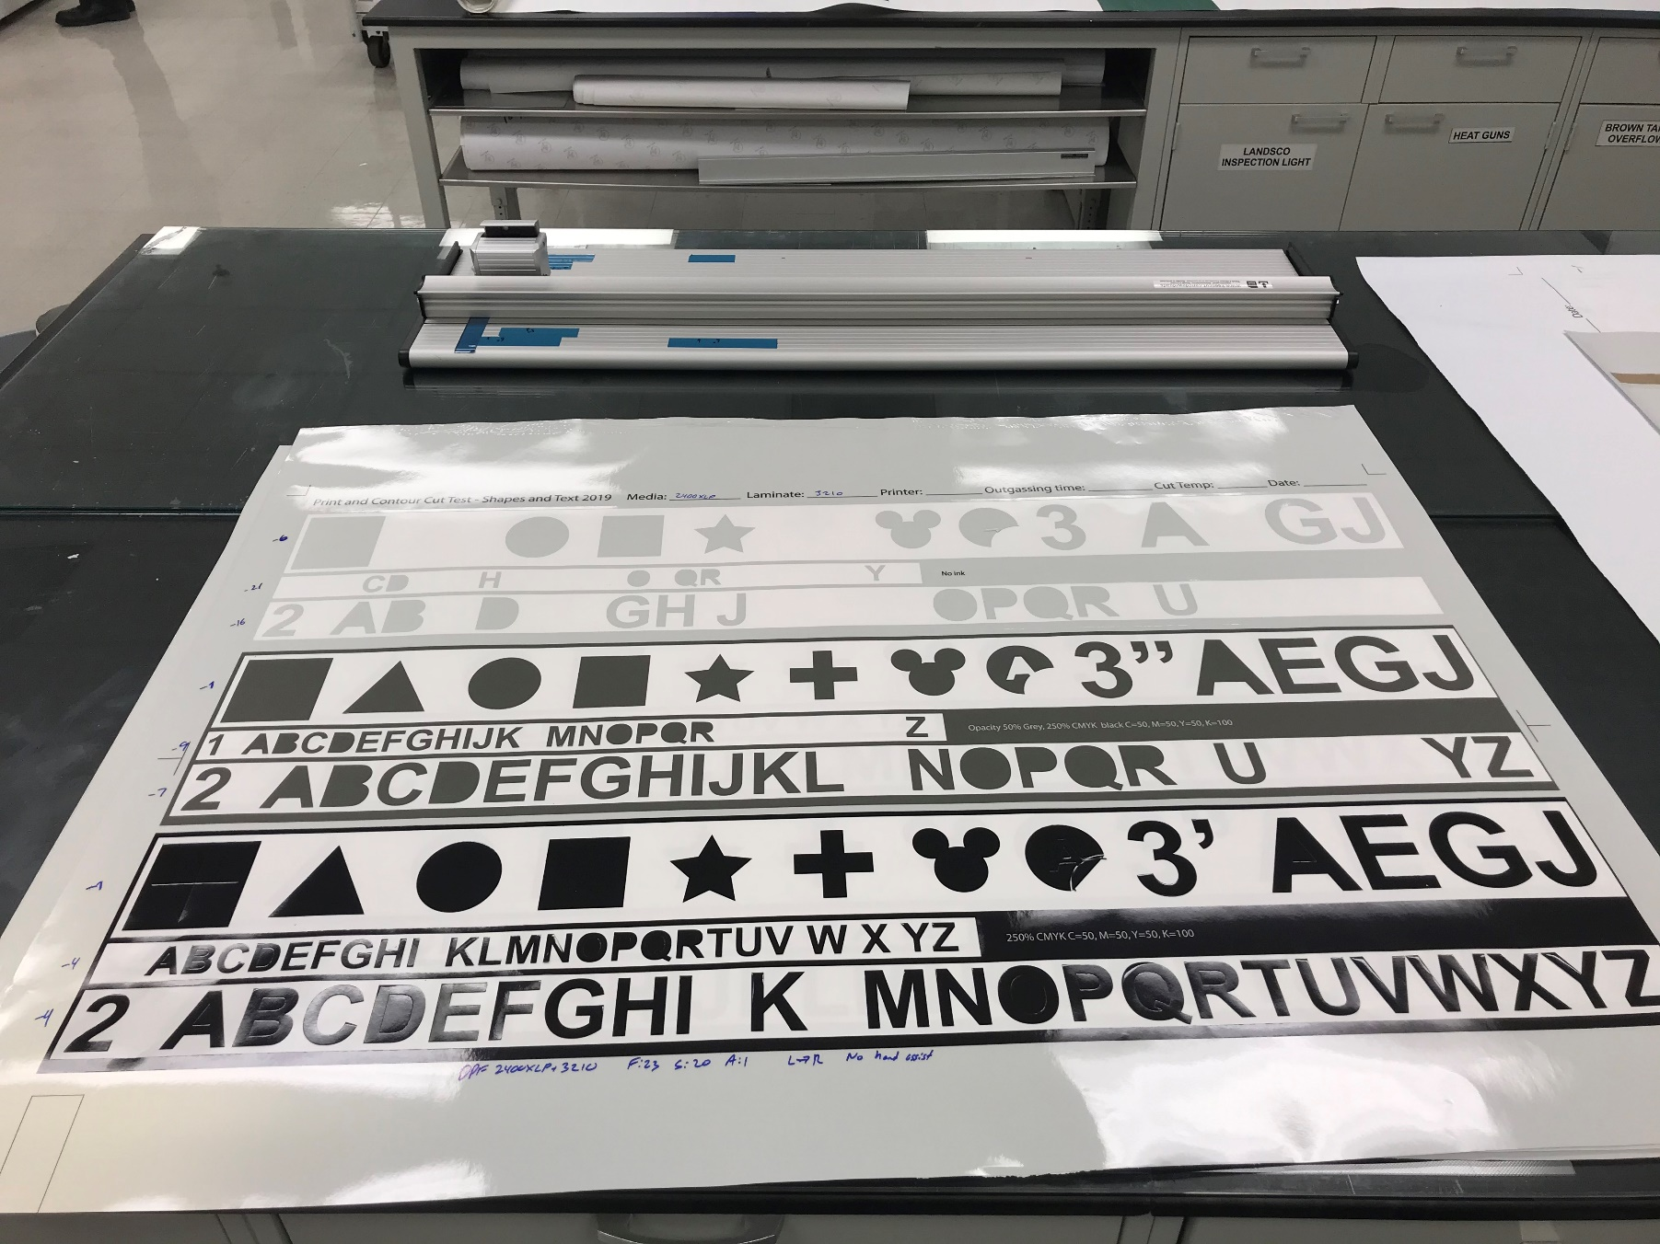
DPF 2400XLP Cut/Weed
12

Slide 13
Conclusion
13
On various finishes of stainless steel panels, IllumiNITE V2 peel adhesion performs comparably to 2400XLP and 2400
IllumiNITE V2 cuts/weeds better than both 2400XLP and 2400
IllumiNITE V2 can be recommended for cut letters down to 2”
IllumiNITE V2 transfers adequately with medium tack transfer tape onto painted vehicle body

Slide 14
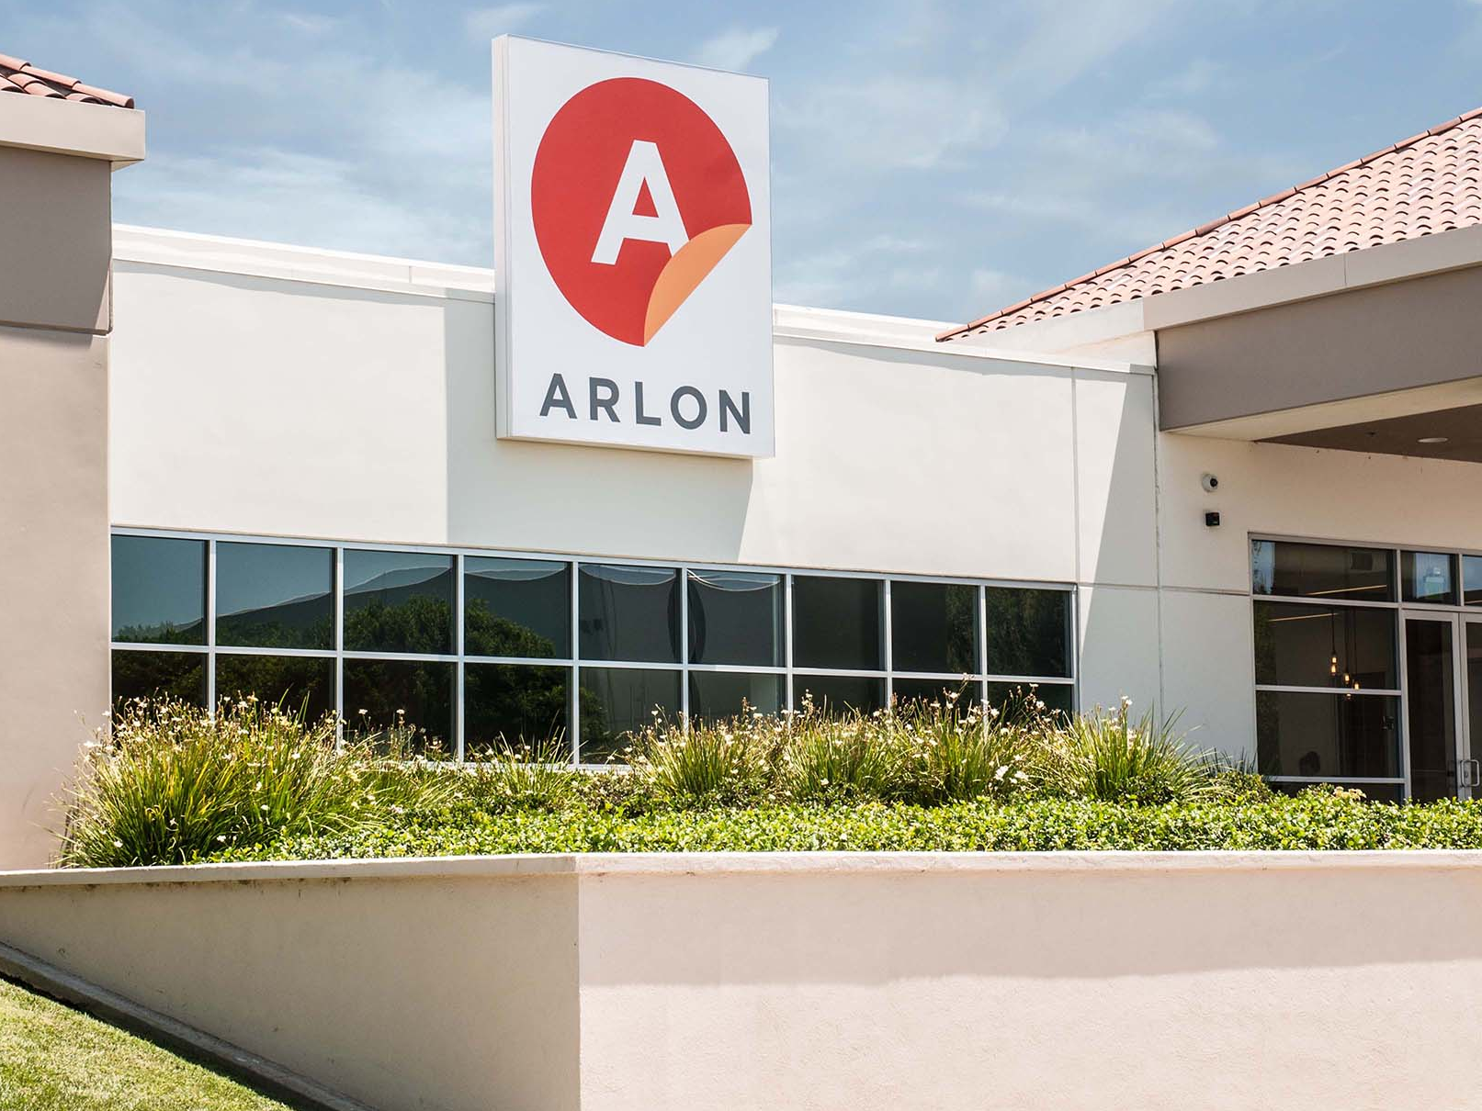
QUESTIONS?

